Slide 1
Genealogy
by
Terri Hanlon

Slide 2
Begin
Why do you want to research your family?
Ancestor & Descendant Charts
Consult Additional Sources: Others & Individual Sources
Collect Previous Research
Compile the info
Notes:
Q.
Show FTM Ancestor Chart
Show Individual Page
Show Family Group Page
Other Source link
Compile info gradually & ALWAYS enter the “Source”

Slide 3
Build
Buy a Book
LDS site
MyFamily.com
Ancestry.com
Family Tree Genealogy Program

Slide 4
Family Search.org
https://www.familysearch.org/
Go to Previous Site
What’s New
Family History Lesson Series provides useful guides
7 Lessons
Notes:
Reader’s Digest of Genealogy
The new site & the old or Original site.

Slide 5
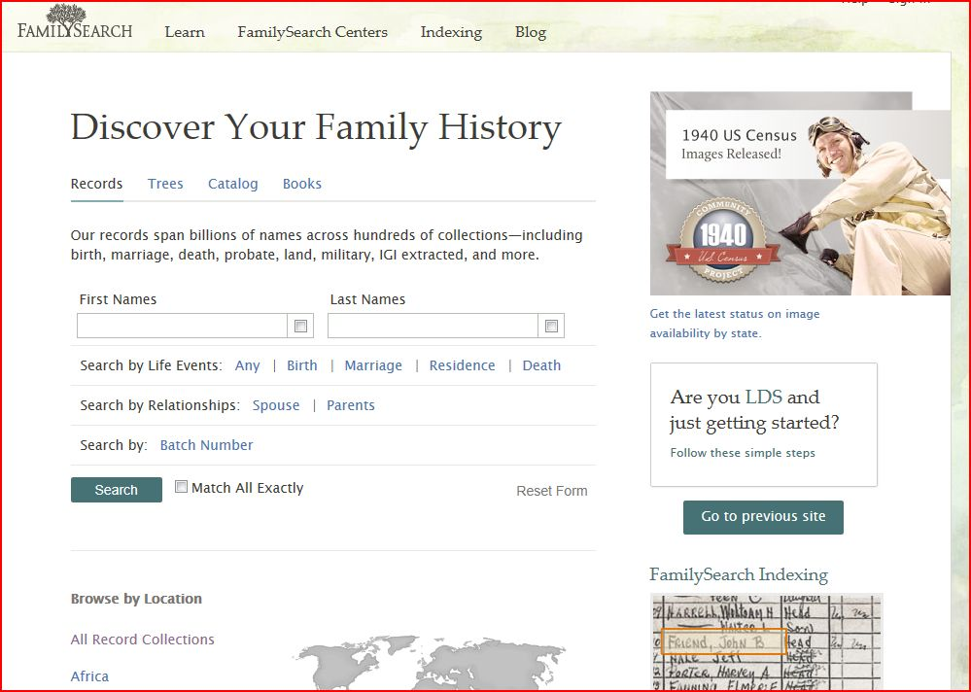
LDS

Slide 6
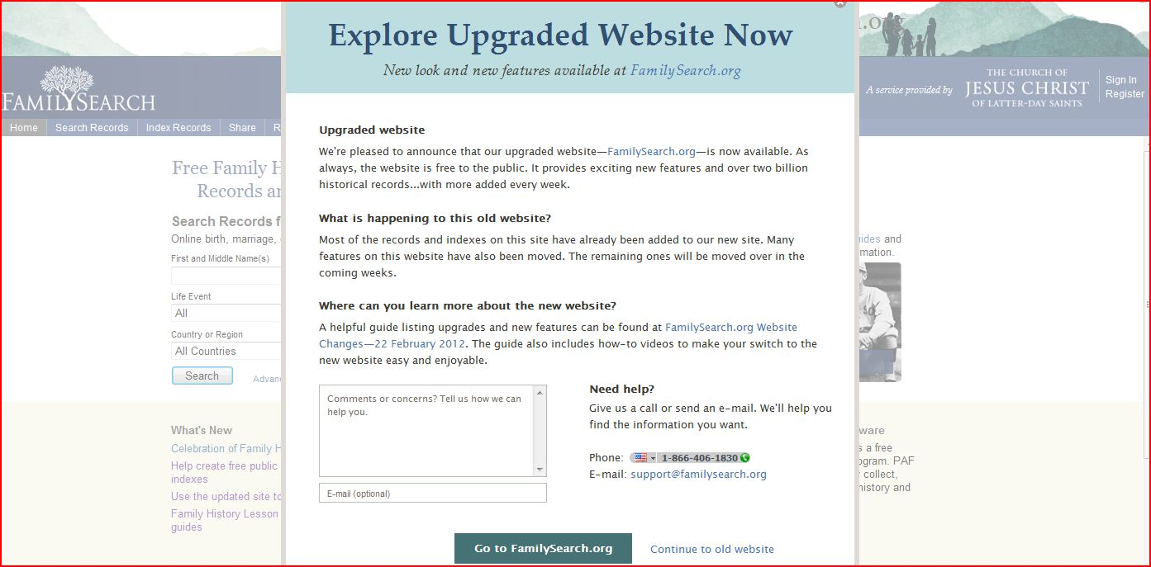
LDS

Slide 7
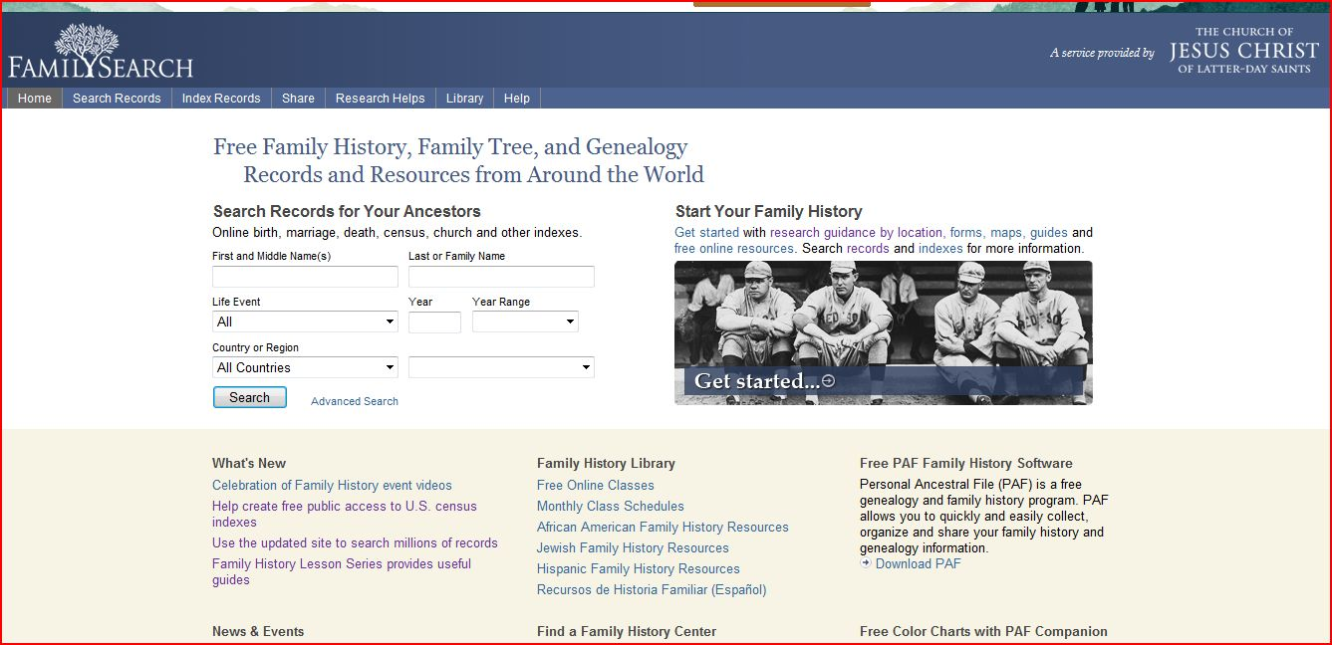
LDS

Slide 8
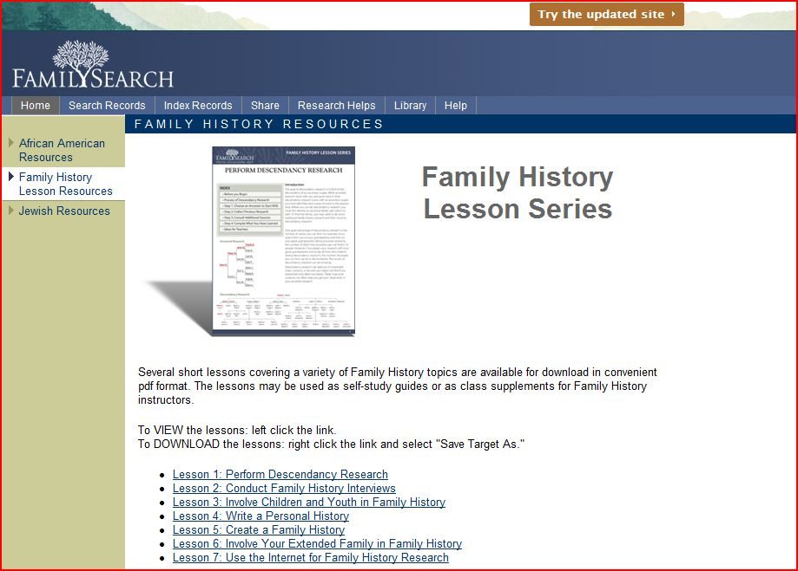
LDS

Slide 9
The Interview
Whom to Interview
Before the Interview
  Supplies: Charts, forms, pencil with eraser, recorder, camera, photos
  Questions: Personal, be a good listener
  Releases: to share information
At the interview
After the interview
Notes:
Supplies:

Slide 10
Interview
What is your earliest memory?
What were some of your family’s traditions?
What was the happiest day of your life?
Tell a story your mother or father told you when you were young.
What places have you visited?
What family heirlooms do you have?
What childhood games did you play?
Tell about a childhood hiding place.
What were Sundays like when you were growing up?

Slide 11
Interview
What prayers have you had answered?
Describe the most serious illness or accident that you have had.
Do you remember any of your grandparents? Any great-grandparents? What were their names? What were they like?
What were your siblings like?
What trips or vacations do you remember?
What special events took place in your neighborhood while you were growing up?
What was your hometown like?
What were politics like there?

Slide 12
Interview
How many people were in your family? Describe each family member.
What kinds of household chores did you do as a child? Which did you enjoy? Not enjoy?
What aunts, uncles, or cousins do you remember? What were they like?
Tell about family traditions for holidays and birthdays.
Did you belong to any clubs or social groups? What were they like?
What were your favorite childhood activities?
Did you serve in the military? If so, where and when? What was it like?
What special school memories do you have? Who were your favorite teachers?

Slide 13
Interview
What challenges did you face as a child?
What challenges have you faced as an adult?
How did you first meet your spouse?
How did your father spend his time?
How did your mother spend her time?
Tell about ancestors you know about—names and dates and any stories about them.

Slide 14
Interview
What are the names of your children? What are their birth dates, where were they born, and what were the circumstances of their births, and their lives?
Tell about some of the most notable people in your hometown.
Tell about some of your neighbors as a child, as a youth, and as an adult.
What changes have you seen in your lifetime in technology, society, politics, and so on?
Tell about the house in which you live. Where else have you lived?
Tell about the house you lived in during your childhood. Do you remember addresses or phone numbers?
Notes:
Could also use these questions for your own memoirs.

Slide 15
search
Main Persons First
Family Tree Maker Software
Ancestry.com
My Family.com
Facebook.com, Yahoo, AOL, Google
Magazines, Books, CDs, Libraries, Family History Centers, etc.
Notes:
Show software details.
Show Ancestry options
Show family website
Show Facebook family site

Slide 16
Involve the children
Interview about lifestyles
Stories, personal histories
Heirlooms & photographs
Attend Reunions
Field trips & Games
Entertainment – movies, slides, Bingo
Tie to school work for the children
Notes:
Lifestyles -
Stories –
Heirlooms – jewelry, artwork, furniture
Show reunion family pictures
Field trip to grandparents’ homes
Entertainment- Oconawa slides, Bingo at Dad’s 80th birthday: umbrella hats, socks w/o tops, bow ties
Kids: can get wrong information when working on school family history projects.

Slide 17
Design
Check Accuracy of Information
Biography, Journal, Oral History, Chronological History
Brief Personal Narratives, Life Highlights, Memoirs
Electronic
Add Pictures / On-line Photo Books
Scrapbooking
Appendix: Questions on all websites, books & magazines
Appendix: Care and Preservation: photos, recordings, artifacts
Archival safe products, humidity free, frame, shadow boxes
Notes:
Electronics?

Slide 18
Create a Personal History
Start With Yourself
Record spontaneous thoughts.
What do you want people to know or remember?
Start looking through photos.
  Pick favorites or life milestones.
  Organize chronologically.
  Scan the photos, slides or movies.
  Add titles, notes, stories.

Slide 19
Create a Family History
What is a Family History?
Why
When
Before you Begin
Layout
Things to consider
Notes:
Why
When – timetable
Before
Layout – shop FTM book
Consider

Slide 20
Create a Family History
Start - names, dates, forms, confirmations
Things to Include - pictures, documents, stories
Review - accuracy
Evaluate - flow
After the Review

Slide 21
Involve the Family
Family Helpers
  Gather information
  Compile data
  Family Newsletter
  Family Website
  Family Reunion – books, magazines, software
  Family Artifacts – quilts, slide shows, family movies
  Family Health and Genetic Data Base

Slide 22
start with yourself
Record spontaneous thoughts.
What do you want people to know or remember?
Start looking through photos.
  Pick favorites or life milestones.
  Organize chronologically.
  Scan the photos, slides or movies.
  Add titles, notes, stories.

Slide 23
Share
World Family Tree
Family Web Site
CD
Printed Book – loose-leaf binder, hard bound

Slide 24
What’s New?
DNA for Family Migration and Trace Health
Tablets, PDAs, GPS
Hand Scanners, Portable Printers,
Phones, Cameras, Tape Recorders
Flash Drives, Portable Storage Devices

