Slide 1
Windows 10 Technical Preview
February 7, 2015

Slide 2
Presentation
Microsoft’s Challenges
Windows Evolution / Win 10
Information Sources
Demonstration
General discussion

Slide 3
Microsoft’s Challenge
Microsoft Windows rules – for PCs
Microsoft is a non-factor in mobile computing
Mobile devices came on market in 2008
With no MS devices, users bought Apple / Android
How does Microsoft bring them back?
And, how does Microsoft compete in the IoT world?

Slide 4
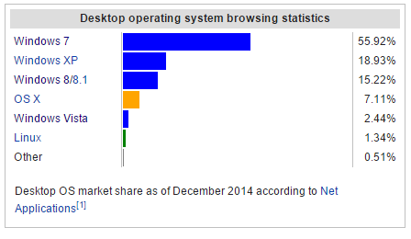

Slide 5
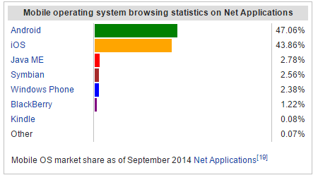

Slide 6
Windows Evolution
Windows 7 included “Aero” “Snap”, the ability to pin apps to the taskbar, Windows Media Center.
By 2010 /2011 it was clear that Microsoft had to look beyond the desktop.
Win 8 added touch functionality, “Modern” Start screen, Modern IE and the Charms bar. The Start Menu was changed. Windows Media Center became optional. Efficient use of hardware!

Slide 7
Windows 10
January video presentation laid out Microsoft strategy for Win 10
One OS for all products – large & small
Hardware versatility; input versatility
New – Cortana, Project Spartan, Xbox, Office
Cloud-centric
New directions – Holograms, Surface Hub
Continued emphasis on hardware efficiency

Slide 8
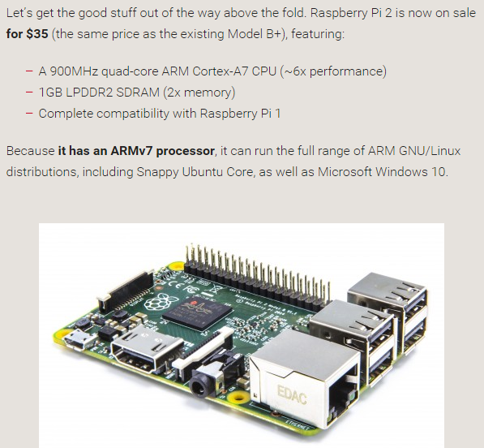

Slide 9
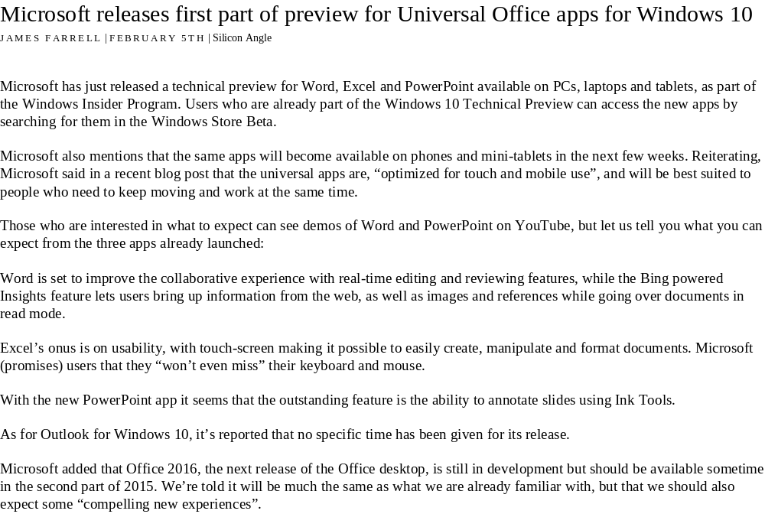

Slide 10
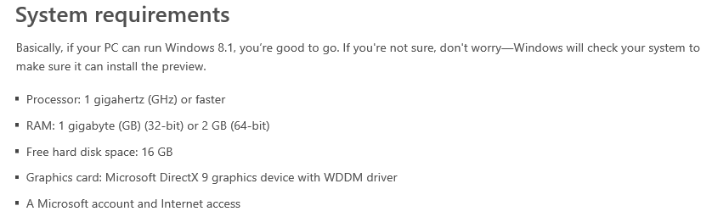

Slide 11
Windows 10
Windows Insider launched with Win 10 Technical Preview, in September 2014. First Build was 9841.
Currently there are 1.7M Windows Insiders
Windows Insider seeks feedback from users; intent is to incorporate that into further modifications.
Build 9926 was issued after the video presentation on January 23rd.

Slide 12
Windows 10
Windows 10 is a work in process; the final product may or may not closely resemble the current Build.
Win 10 Technical Preview for phones in February
The Windows Insider program ends April 15th.
No launch date yet. My guess is October.
Microsoft is promising free upgrades from Win 7 & Win 8 / 8.1 to Win 10 for one year after launch.

Slide 13
Windows 10
At this stage, Windows 10 does not look much different from Windows 8.1.
The Start Menu is unchanged from Win 8.1
The Charms bar is gone.
Modern Internet Explorer is gone. (Spartan?)
Cortana has been added.
Designed to auto-open with the correct screen.
“Modern” Start screen has changed somewhat.

Slide 14
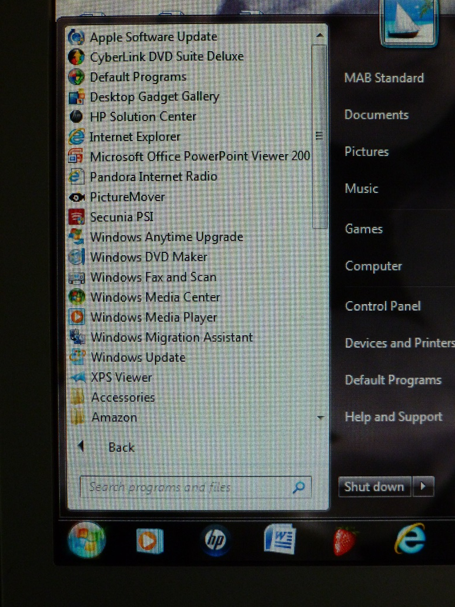
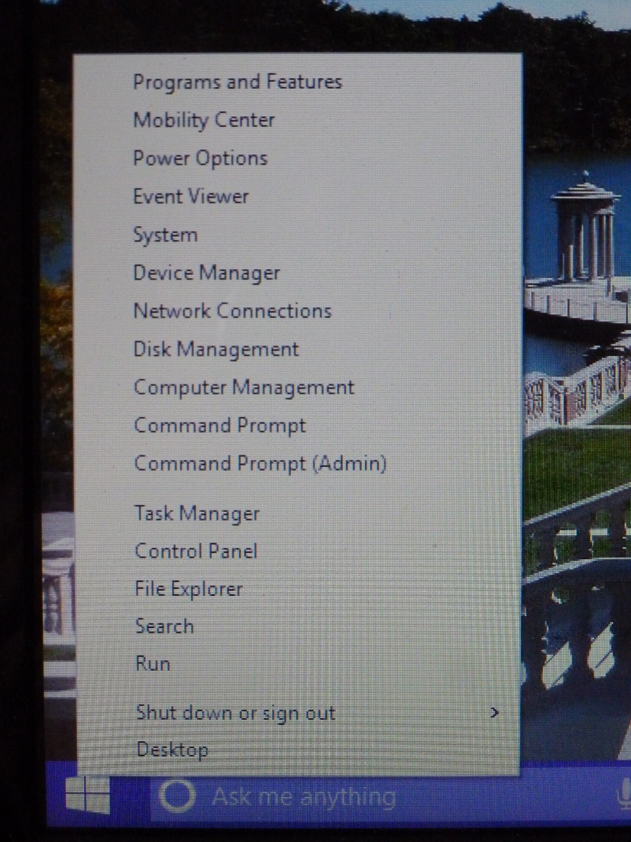
Start Menu Comparisons
Win 7
Win 8.1 Win 10

Slide 15
Windows 10
Sources of information:
  Computer magazines (PC World, PC Magazine)
  Windows Secrets newsletter
  Various non-Microsoft websites
  Microsoft’s Windows Insider website: (windows.microsoft.com/en-us/windows/preview)
  Win 10 Technical Preview community forum
  Microsoft’s Windows 10 blog

