Slide 1
Our 2020 Technology Plan
September 2019

Slide 2
Why bother with a plan?
  We could address our technology questions, concerns and opportunities piecemeal
  But having a plan can lead to better results with less effort – and ensure that we focus on our most important needs & opportunities
  We have three months left in 2019 – let’s use them to create a 2020 Technology Plan!

Slide 3
Potential benefits of a technology plan
  Minimize technology frustrations
  Protect against identity theft and/or scams
  Use technology to improve our lives
  Get the best “bang for our buck”
  Prepare for incapacitation / death
  Other?

Slide 4
Minimize technology frustrations
  What technology frustrations do we have?
  Do others look to us to help deal with their frustrations?
  What is causing them?
  What must happen to make them go away?

Slide 5
Address technology frustrations
  Learn to communicate with tech on its terms
  Keep your hardware and software up-to-date
  Learn / use tech “house-keeping” tips & tricks
  Turn to Internet search / trusted websites for help
  Call upon LCACE, friends, etc. for help & advice
  Other?

Slide 6
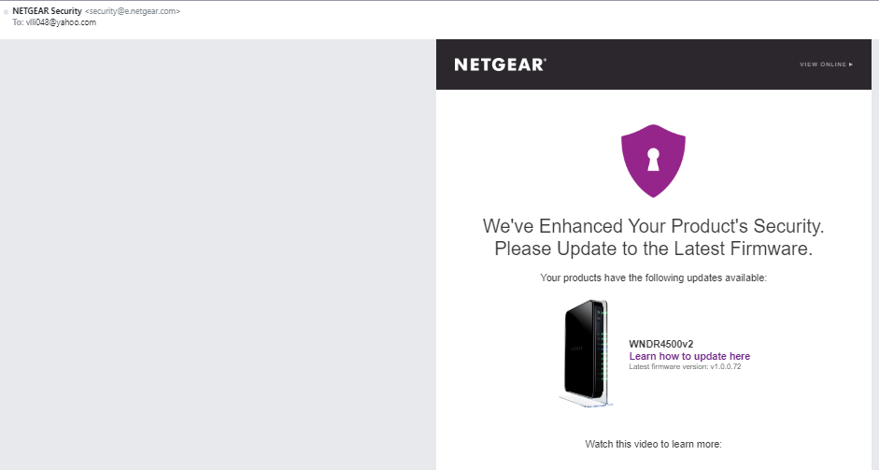
A router firmware update reminder

Slide 7
Identity theft and/or scams
  Hardware / software attacks
  Scams
  Extortion

Slide 8
  Hardware / software attacks
    Computers, tablets, smartphones
    Routers / networks
    IoT devices (security cameras, smart home)
    Internet vs. Wi-Fi vs. Bluetooth vs. other?
    Other?

Slide 9


Slide 10
Protect against hardware /software attacks
  Make sure that our hardware and software is up-to-date
  Install and use robust anti-malware software
  Change settings (hardware, OS, browsers, etc.)
  Utilize secure Wi-Fi networks / VPNs
  Other?

Slide 11
  Scams
    Phishing emails
    Malicious pop-ups
    Malicious websites
    Phone scams
    Other?

Slide 12
Protect against scams
  Read and save news about scams
  Build a list of actions to take or avoid
  Do not engage with potential scammers
  Seek info / advice from others before you act
  Identify “helpers” you can turn to if scammed
  Other?

Slide 13
  Extortion
    Ransomware
    Threatening / scary emails or phone calls
    Other?

Slide 14
Protect against extortion
  Read and save news about extortion attacks
  Ensure your anti-malware blocks ransomware
  Back up all personal files – with an “air gap”!
  Have a plan to reinstall all application software
  Identify “helpers” you can turn to if extorted
  Other?

Slide 15
Identity Theft
  Identity theft can take many forms and deserves a thorough discussion beyond the scope of this presentation.
  Suffice to say, this is an important subject for us all and should be part of an overall “protect ourselves from the bad guys” plan!

Slide 16
Use technology to improve our lives
  How are we using existing technology?
  Are there opportunities to increase our use?
  What technology changes are in the works?
  How can we take advantage of those changes?

Slide 17
How are we using existing technology?
  What basic technology needs do we have?
  Can we drop any needs, or combine with others?
  Make better use of current technology?
  How? Why? In what priority? On what timetable?
  Affirm / reaffirm which tech providers to use
  Other?

Slide 18
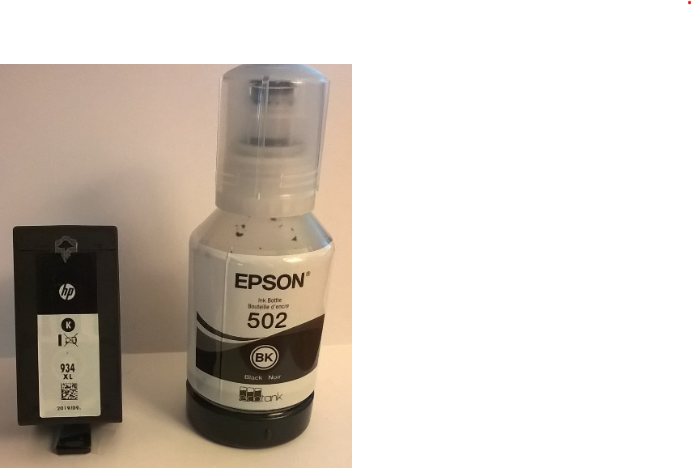
New technology is not always dramatic!

Slide 19
Affirm / reaffirm which tech providers to use
  Apple / Microsoft / Google / Linux – or a mix?
  Misc. hardware – printer, router, smart home, etc.
  Functionality vs. ease vs. cost?
  Software: Which? Why? Support? Cost? Etc.
  Other?

Slide 20
Stay attuned to new / changing technology
  Windows 7 no longer supported after 1/15/2020
  Wi-Fi 6 rolling out in 2020
  5G wireless is currently in test; rolls out in 2020 and beyond
  EdgeChromium browser roll-out in 2020
  T-Mobile / Sprint merger
  Multiple USB options
  Other?

Slide 21
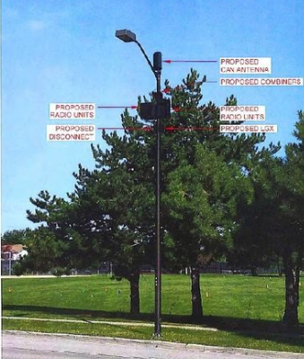
Graphic rendering of a 5G antenna on a streetlight

Slide 22


NETGEAR Nighthawk AX8 8-Stream WiFi 6 Router (RAX80) - AX6000 Wireless Speed (up to 6Gbps) Coverage for Large Homes | 5 x 1G and 1x 2G Ethernet ports | 2 x 3.0 USB

Slide 23
Ways to stay attuned to new technology
  Look for technology news in mainstream media
  Check out tech websites / newsletters
  LCACE meetings & newsletters; APCUG videos
  Consult knowledgeable friends & family; Internet search
  Technology presentations at libraries / elsewhere
  Other?

Slide 24
Ways to get the best “bang for our buck”
  Align hardware & software to current and anticipated needs
  Reconsider your choice of current or planned providers
  Consider Costco, Sam’s Club and Amazon. (Best Buy and others offer price matching.) Or, consider used / refurbished gear.
  Follow best practices for technology disposal
  Other?

Slide 25
Follow best practices for technology disposal
  Become knowledgeable about environmental and security concerns associated with disposal
  Consider donating items in good condition (LCACE?)
  Recycle everything else at local electronic recycling events / facilities or at Best Buy or other retailers.
  Be sure to “wipe” or otherwise remove personal data from donated or recycled items
  Other?

Slide 26
Prepare for incapacitation / death
  Several years ago we talked about “Digital Afterlife”
  Just as we accumulate physical / financial “stuff” during our life, we also accumulate digital “stuff”
  What is to be done with our digital life if we become incapacitated or die?
  Here’s a video reminder: https://youtu.be/QaZMfoUQdTc?list=UUxDTDRVp6jZy_MTSoq7mJsg

Slide 27
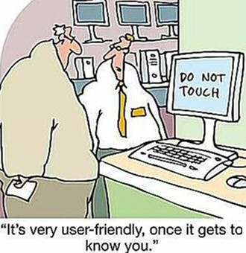
Anything Else?

Slide 28
“Failure to plan is planning to fail”
Make 2020 a great year for your technology!

