Slide 1

Show ‘n tell
What’s new in my toy box
J.J. Johnson

Slide 2

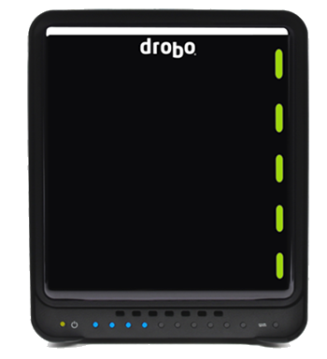
Direct attached storage
First Drobo 2011
5 registered drives
90 TB storage
Highly recommended for photographers
Notes:
5 Registered Drobos
90 TB Storage
Drobo FS 2011
Drobo 5N2 2018

Slide 3


Slide 4
5c
Self-Managing
USB-C
5-bays
Beyond Raid Technology
Quick easy setup
64 TB
Battery-backed memory
Protect data against hard drive failures and sudden power outages,
Notes:
Protect data against hard rive failure and sudden power outages
Advance self-healing by creating a second volume

Slide 5
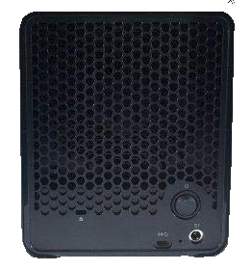
5c
Self-Managing
USB-C
5-bays
Beyond Raid Technology
Quick easy setup
64 TB
Batttery-backed memory
Notes:
Protect data against hard rive failure and sudden power outages
Advance self-healing by creating a second volume

Slide 6
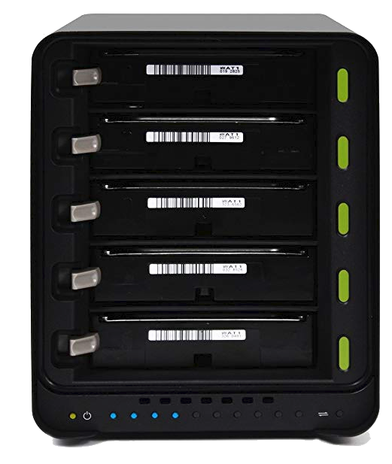
5c
Self-Managing
USB-C
5-bays
Beyond Raid Technology
Quick easy setup
64 TB
Battery-backed memory

Slide 7
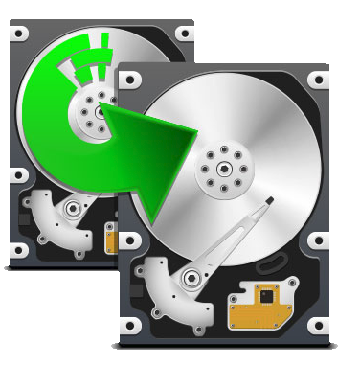
5c
BeyondRAID storage technology that protects data against a hard disk crash, yet is simple enough for anyone to use. As long as you have more than a single disk in Drobo, all data on Drobo is safe no matter which hard disk fails.
Self-Managing
USB-C
5-bays
Beyond Raid Technology
Quick easy setup
64 TB
Battery-backed memory
Click graphic to view video
Notes:
RAID 1980s
Block leave date write
More space by simple adding a new drive or replace smaller drives
Single / double redundancy CLICK

Slide 8


Slide 9
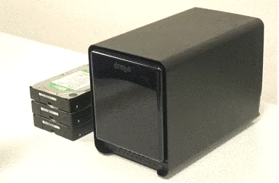
5c
Remove faceplate
Press drive lock
Insert drive(s)
Replace faceplate
Connect USB cable
Attach power cable
Turn on Drobo
Wait sever minutes to complete cycle
Flashing blue/yellow
Self-Managing
USB-C
5-bays
Beyond Raid Technology
Quick easy setup
64 TB
Battery-backed memory

Slide 10
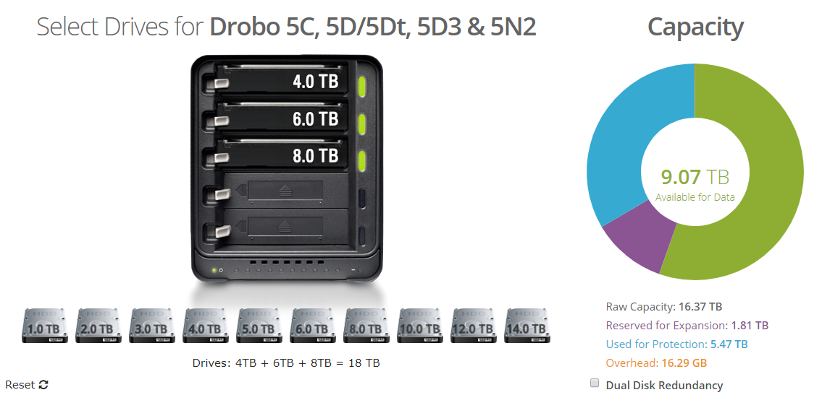
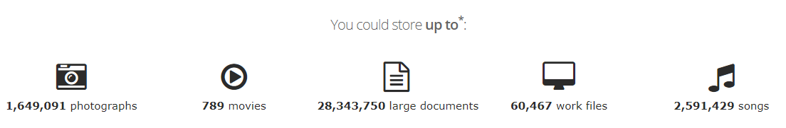
Select drives
Capacity Calculator
Self-Managing
USB-C
5-bays
Beyond Raid Technology
Quick easy setup
64 TB capacity
Battery-backed memory
Notes:
Drive status lights
Health
Capacity

Slide 11
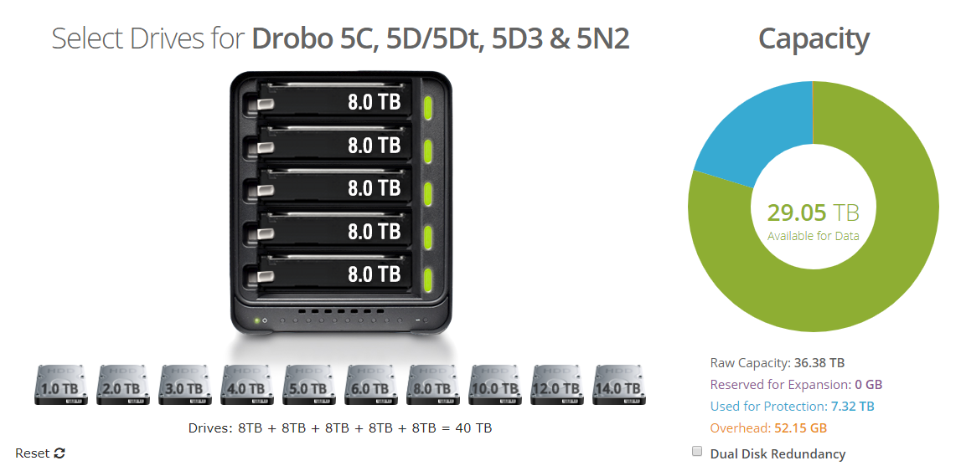
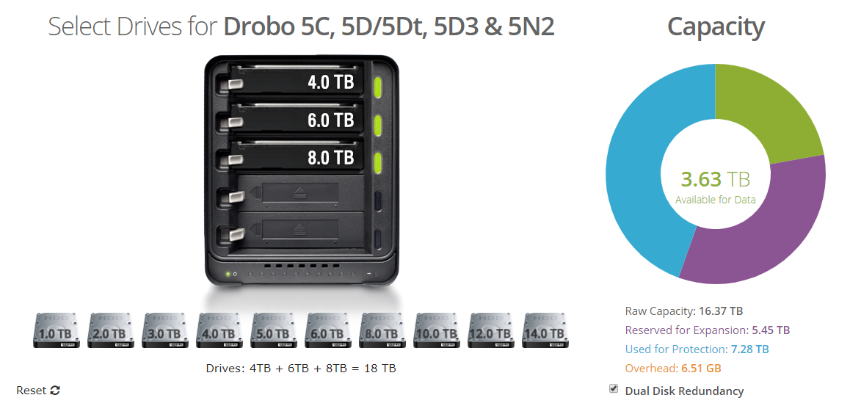
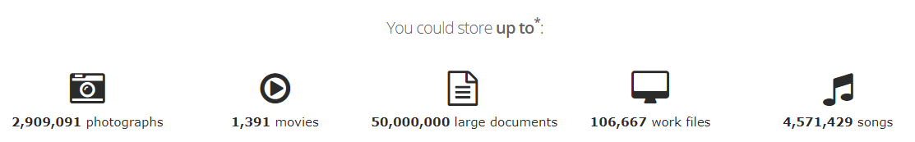
Select drives
Capacity Calculator
Self-Managing
USB-C
5-bays
Beyond Raid Technology
Quick easy setup
64 TB capacity
Battery-backed memory
Notes:
Drive status lights
Health
Capacity

Slide 12
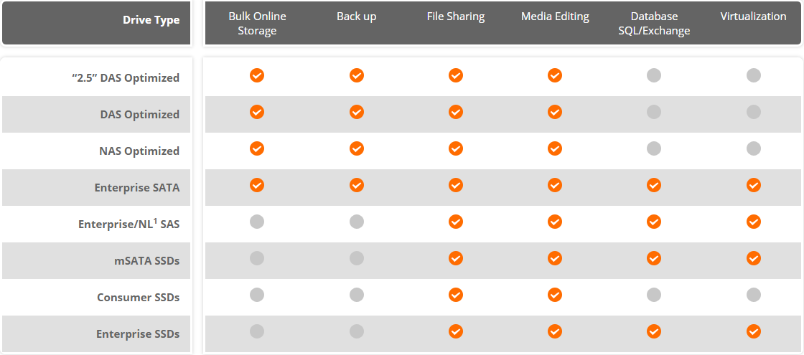
Select drives
Self-Managing
USB-C
5-bays
Beyond Raid Technology
Quick easy setup
64 TB capacity
Battery-backed memory
Notes:
Drive status lights
Health
Capacity

Slide 13
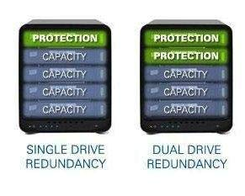
Select drives
Redundancy
  Single drive
  Dual drive
Notes:
One personal
One or several computers at the same time
One dedicated computer (server)

Slide 14

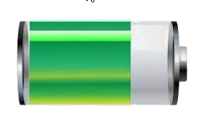
Protection
Self-Managing
USB-C
5-bays
Beyond Raid Technology
Quick easy setup
64 TB
Battery-backed memory
Power Protecting Critical Data
Battery backup protects memory cache, during power loss.
Saves in process data to internal SSD
Notes:
When power spontaneously goes away, Drobo moves any in flight data to onboard flash in your Drobo so it will be protected and moved to your disk drives once power is restored.
This ensures your important information is safe and sound. Even better, your battery recharges itself and is designed to last for the life of your Drobo 5C.

Slide 15
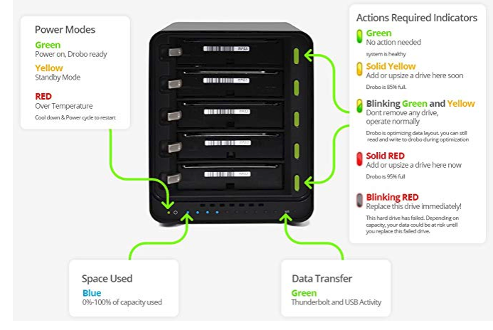
What’s happening?
Power Modes
Action Indicators
Space Used
Data Transfer
Notes:
One personal
One or several computers at the same time
One dedicated computer (server)

Slide 16
Right drobo for you?
4 Step Help
  How many at the same time
  How do you plan to use you Drobo?
  How many terabytes
  Ideal storage
Notes:
One personal
One or several computers at the same time
One dedicated computer (server)

Slide 17
Right drobo for you
4 Steps
  How many at the same time
  How do you plan to use you Drobo?
  How many terabytes
  Ideal storage
Notes:
Like a big extension of my hard drive
Like an archive back up
Media and editing photos or video

Slide 18
Right drobo for you
4 Steps
  How many at the same time
  How do you plan to use you Drobo?
  How many terabytes
  Ideal storage
Notes:
Less than 16 terabytes
16-31 terabytes
32-48 terabytes
More than 48 terabytes

Slide 19
Right drobo for you
4 Steps
  How many at the same time
  How do you plan to use you Drobo?
  How many terabytes
  Ideal storage
Notes:
The it will tell you which drive is ideal for storge

Slide 20
Drobo 5c
Capacity Calculator
Drive Selector
Drobo Migration

Slide 21
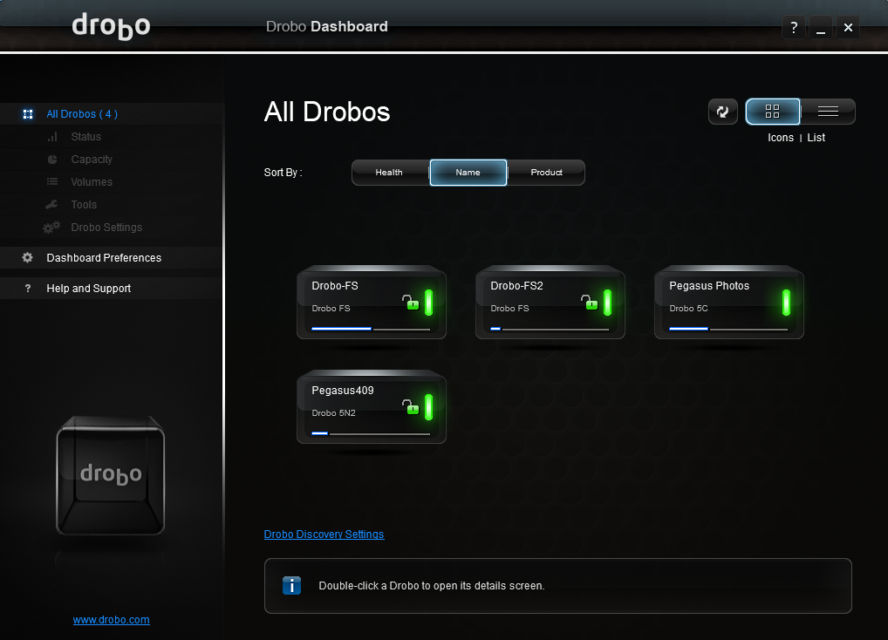
dashboard
All Drobos (4)
Status
Capacity
Volume
Tools
Drive Settings
Preferences

Slide 22
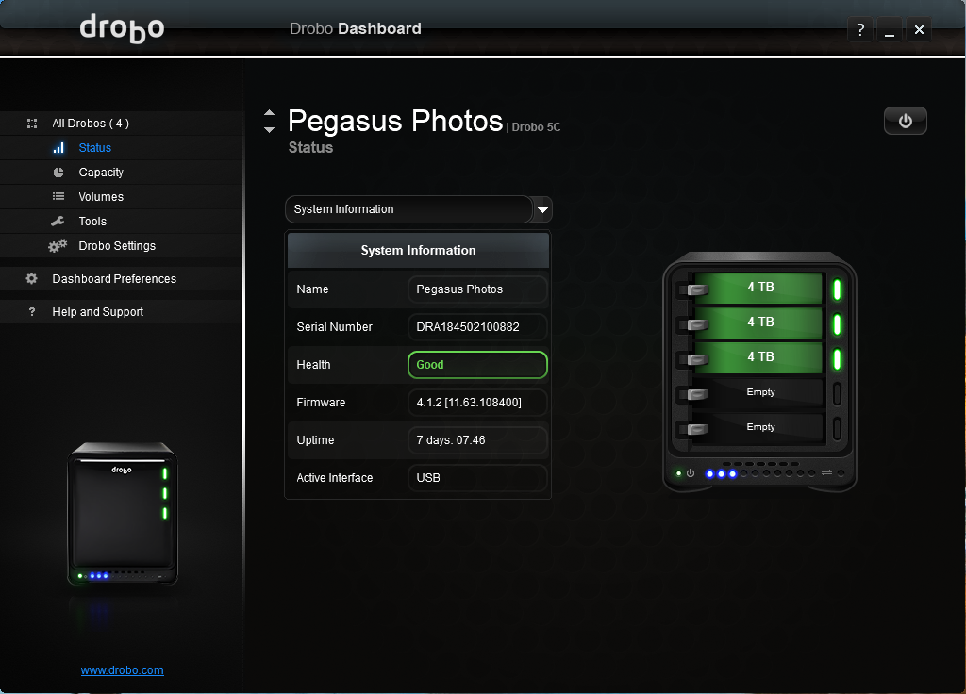
dashboard
All Drobos (4)
Status
Capacity
Volume
Tools
Drive Settings
Preferences

Slide 23
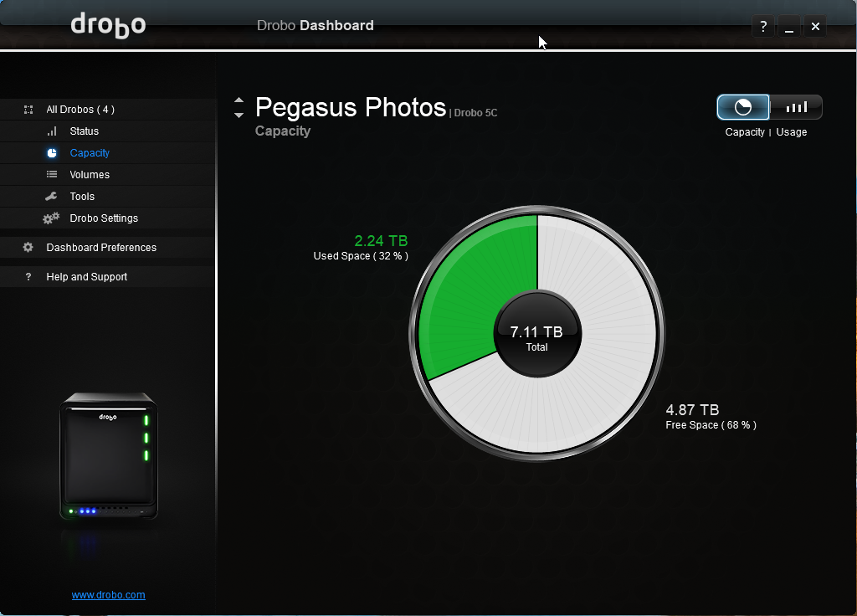
dashboard
All Drobos (4)
Status
Capacity
Volume
Tools
Drive Settings
Preferences

Slide 24
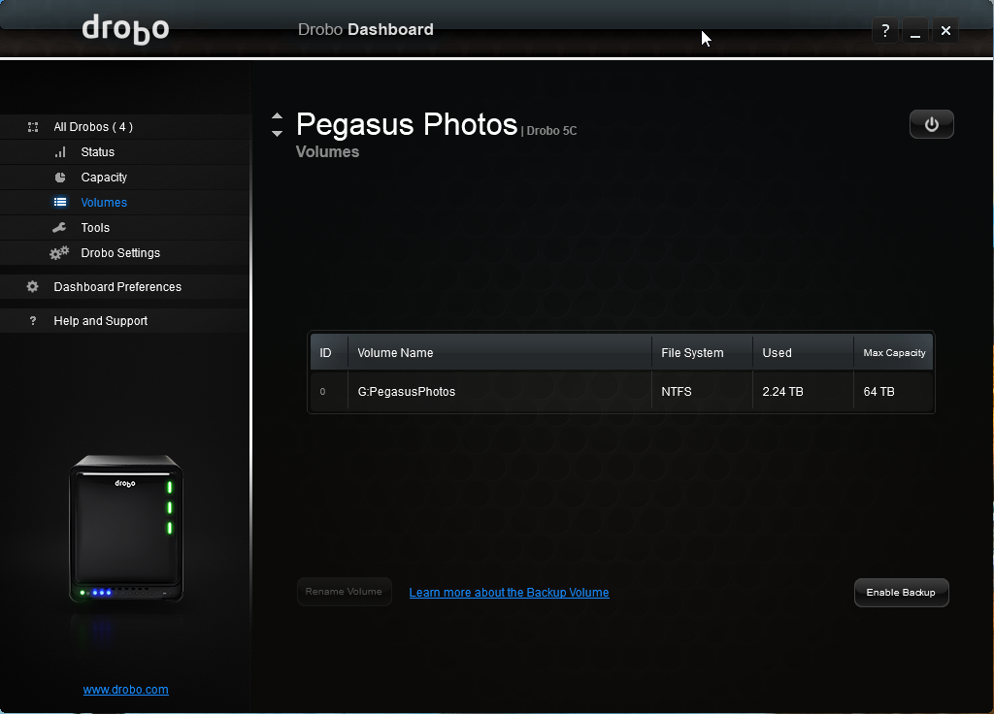
dashboard
All Drobos (4)
Status
Capacity
Volume
Tools
Drive Settings
Preferences

Slide 25
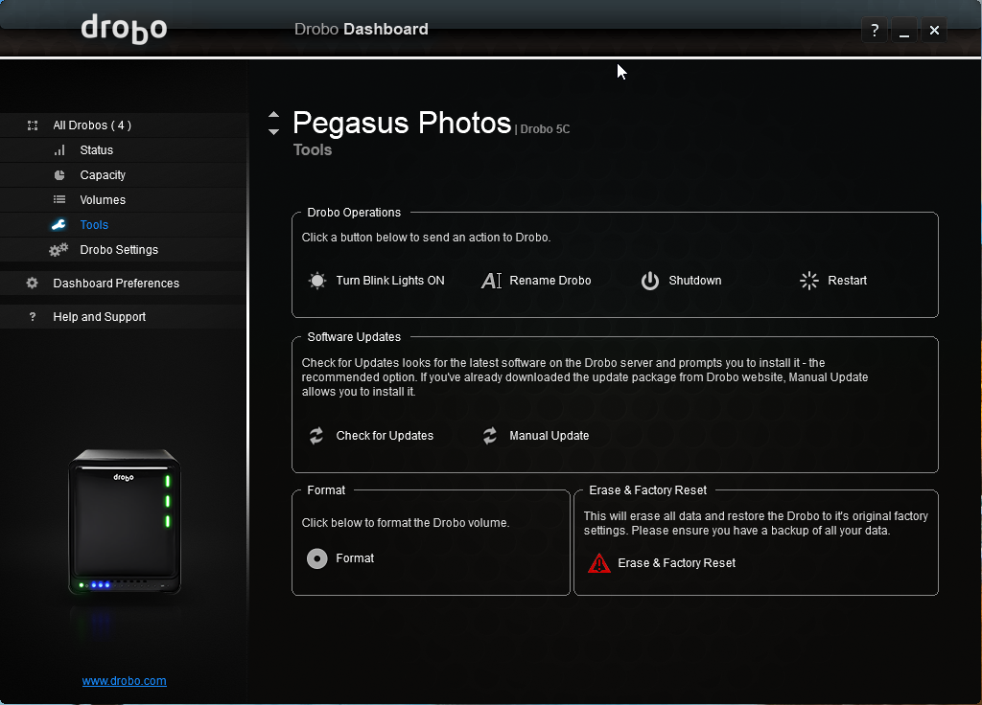
dashboard
All Drobos (4)
Status
Capacity
Volume
Tools
Drive Settings
Preferences

Slide 26
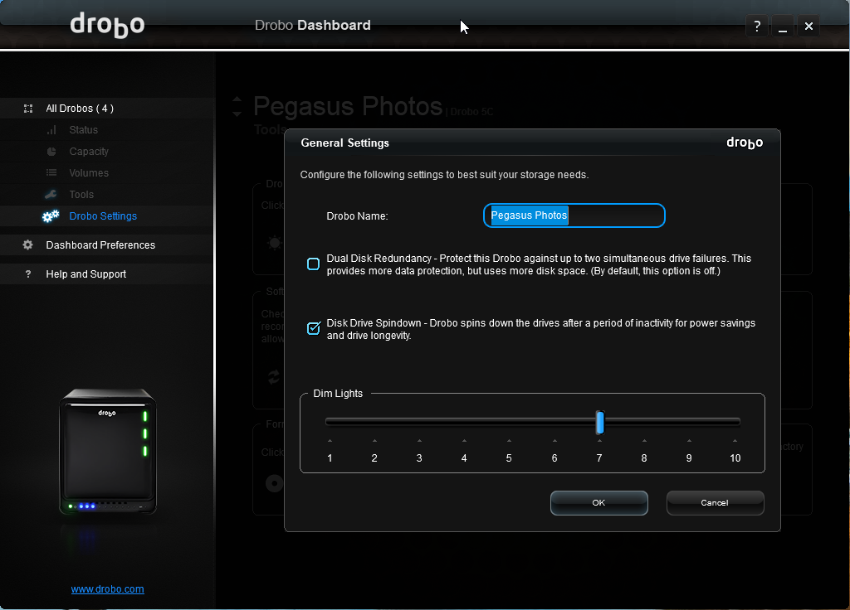
dashboard
All Drobos (4)
Status
Capacity
Volume
Tools
Drive Settings
Preferences

Slide 27
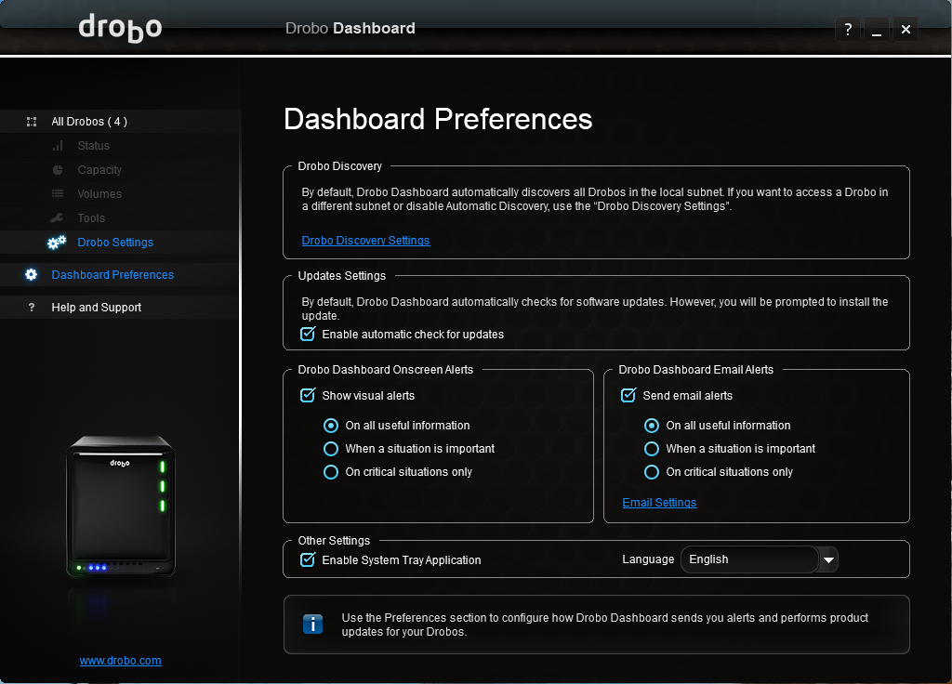
dashboard
All Drobos (4)
Status
Capacity
Volume
Tools
Drive Settings
Preferences

Slide 28
dashboard
All Drobos (4)
Status
Capacity
Volume
Tools
Drive Settings
Preferences

Slide 29
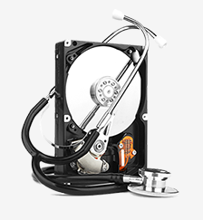
Drobocare
Standard Warranty
Extended Care
24/7 technical phone support
Migration Assistance
Notes:
Drive status lights
Health
Capacity

Slide 30


Backup
2 Drobos
Cloud
  Carbonite
  Backblaze
Notes:
Drive status lights
Health
Capacity

Slide 31
pricing
Amazon $286.03
B&H $349.99
eBay: $199.95 (used)

Slide 32

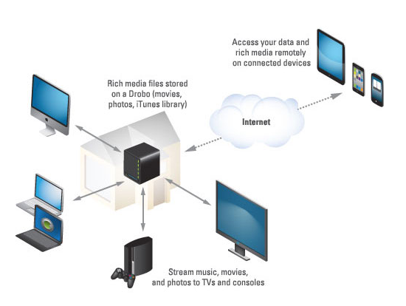
entertainment
5C (2nd)
5 – 8TB Drives (40TB)
Plex Server
  Movies (1100+)
  Music (57,000)
  Photos (2.5 Meg)

Slide 33
Conclusion
Overall, I’m very happy with the purchase. It was fast and easy to setup, works like a typical external HDD after setup, and provides me with all the storage I need now with the option of easy expansion in the future.

Slide 34


Any questions

Slide 35


